Slide 1
Memory Management
Module 4
ITSC205
Operating Systems Internals

Slide 2
Module Objectives
Explain fundamental terms used to describe memory management.
Compare physical and logical memory address
Describe memory allocation techniques
Describe Memory management in Linux and Windows operating systems
Describe Structure of the Page Table
Example: The Intel 32 and 64-bit Architectures

Slide 3
Memory Definition
Memory can be viewed as a linear array of bytes ranging from 0 to n. Memory is a large array of words/bytes
Every location in memory is identified with an address, represented in hexadecimal system
CPU fetches instructions from memory according to the value of the program counter. The Register can be accessed in one CPU clock (or less)

Slide 4
Memory Definition
When the system boots, the kernel reserves part of the physical memory to its own text and static data structure. The rest of the memory is managed dynamically
A region’s memory boundaries are configured using two attributes, the starting address and its length, which can be any power of two between 4 KB and 4 GB.
Main memory can take many cycles, causing a stall (CPU does not have the data needed to complete instruction in execution)

Slide 5
Memory Management Functions
The Operating System must manage all the physical memory and allocate and deallocate it to/from processes.
System services for allocating, deallocating, and managing virtual memory
It manages swapping between main memory and disk, when main memory is not big enough to hold the processes.

Slide 6
Memory Management Functions
Protection of memory is required to ensure correct operation. The operation system assigns to memory regions: access rights and the cache and write buffer policies.
The access to a region in memory is set as read-write, read-only, or no access and is subject to additional rights based on the current processor mode, which is either privileged or user.

Slide 7
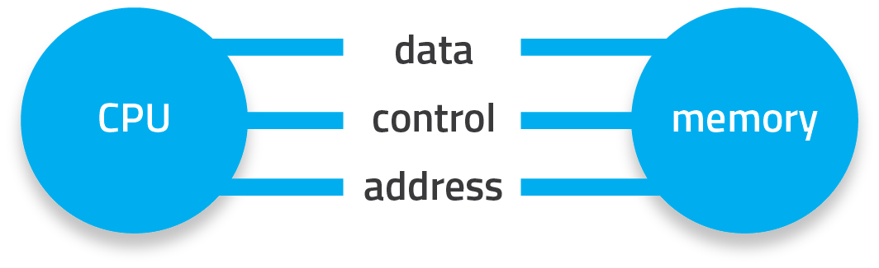
Addressing Memory
Instruction cycles generate requests for data which moves to or from memory
Either instruction or program data
Recall Von Neumann architecture with only one address space for both
Memory address: location of data sent to/from CPU
Usually represented in hexadecimal format

Slide 8
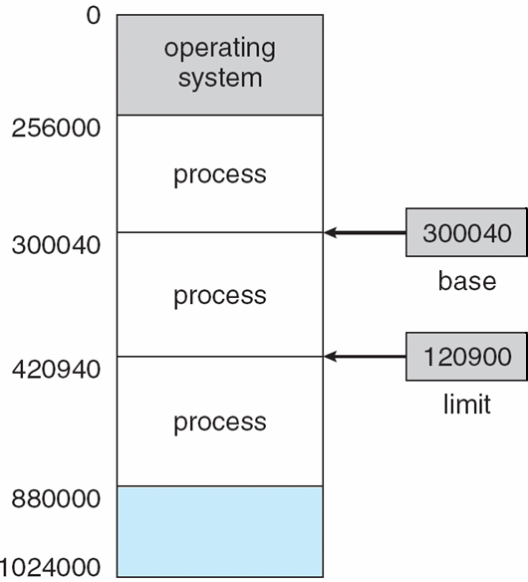
Base and Limit Registers
A pair of base and limit registers define the logical address space
CPU must check every memory access generated in user mode to be sure it is between base and limit for that user.

Slide 9
Binding Instructions and Data to Memory
Address binding of instructions and data to memory addresses can happen at three different stages:
Compile time: If memory location known a priori, absolute code can be generated; must recompile code if starting location changes
Load time: Must generate relocatable code if memory location is not known at compile time
Execution time: Binding delayed until run time if the process can be moved during its execution from one memory segment to another
Need hardware to support for address maps (e.g., base and limit registers)

Slide 10
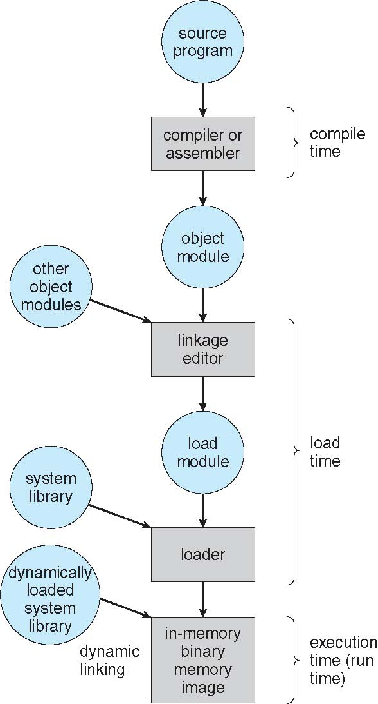
Multistep of user program

Slide 11
Linking
Inserting external code for references
E.g. shared libraries and DLLs
Can be done statically or dynamically
What are the pros and cons of these approaches?
Dynamic Linking is handled by the OS
Creates a stub to reference the library function
And how to load the function if it’s not already loaded into memory
Stub is replaced with physical address of the library function
Shared between all processes that will use this

Slide 12
Loading and Binding
Loading: programs must be brought into memory for execution
Every instruction and data must be stored in a specific location in memory, determine base and limit values
Binding: converts symbolic addresses to memory addresses (mapping)
Symbols: identifiers we use in programs for variables and functions
E.g. int x = 5, where is x?
Notes:
There’s a classic math joke here… :D

Slide 13
Process Address Space
Memory over which a process has control
Each process’ address space protected from other processes
Basic implementation uses two registers, base and limit, to define address space
Base = start address, limit = range of addresses
These values are stored in the PCB of each process
OS loads the base and limit values when that process is chosen to run
Notes:
Note: some literature use the terms “process address space” and “process image” interchangeably… this is not true. A process’s address space is only the process’s code/text, data, bss, heap and stack… but an image of the process contains all resources related to the process – including the PCB (which is not owned by the process itself but by the OS for obvious reasons), the kernel stack (used to track system calls and owned by the kernel) and shared address space (containing shared memory or libraries).

Slide 14
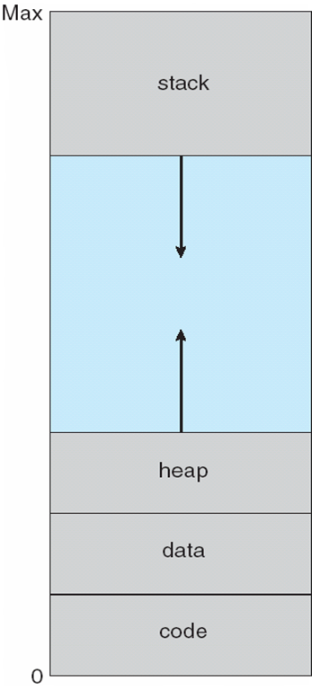
Process Address Space
http://duartes.org/gustavo/blog/post/anatomy-of-a-program-in-memory/

Slide 15
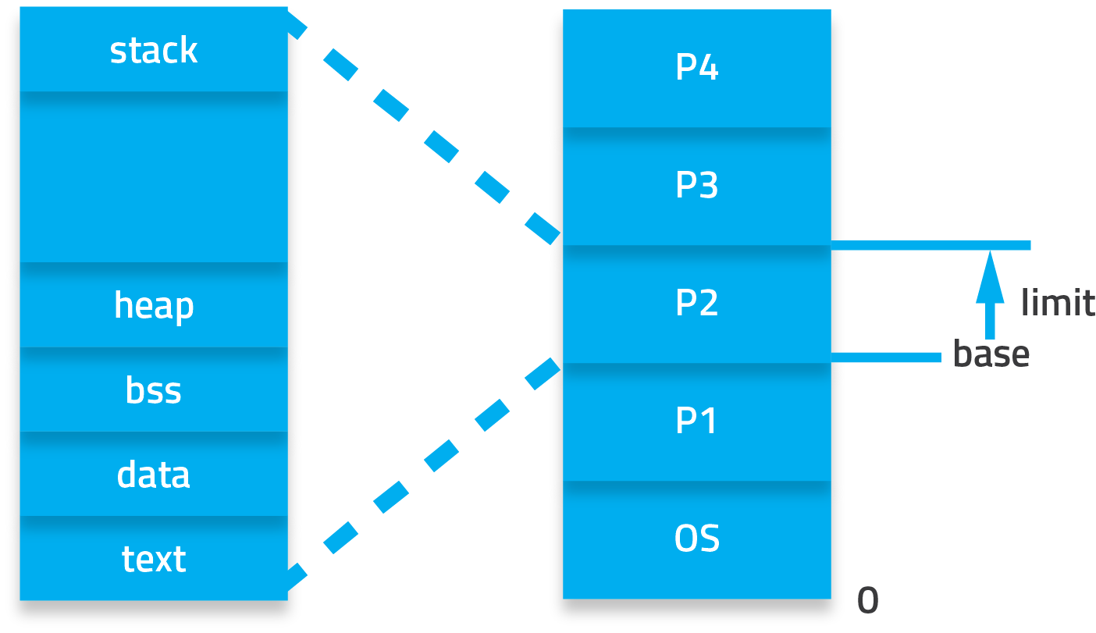
Using Base and Limit Registers
Notes:
How does this simple approach prevent a process from accessing memory it does not own?

Slide 16
The STACK
The Stack is an area in memory where a program temporary stores during execution time the following:
1. Local variables,
2. Function’s parameters
3. Return addresses of a function
The stack grows toward lower addresses.
The stack operates as LIFO (last in, first out ).
sp register points to top of stack

Slide 17
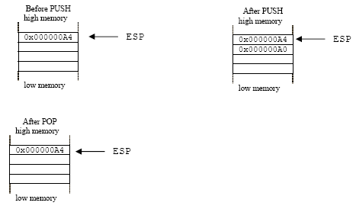
The Stack
Push and Pop stack operations
ESP – CPU register -Stack Pointer

Slide 18
Stack
When a function is called :
The return address ret() of the function will be push into memory
The old base pointer (bp) will be saved in memory
A section of memory will be allocated as buffer with respective size
rbp
Top of Stack
Return Address
Old Base Address
aaaaaaaaaaaaaaa

Slide 19
The Stack
If the area allocated to the stack is not large enough, the executing code will write outside the stack and a memory overflow situation will occur. Stack buffer overflow is a common security vulnerability
If the stack buffer is filled with data supplied from an untrusted user then that user can corrupt the stack in such a way as to inject executable code into the running program and take control of the process.
Underestimating stack usage can cause runtime errors such as overwritten variables, corrupted return address, pointers errors. These errors can be difficult to detect

Slide 20
Stack Overflow
Segmentation Fault – Violation in user space memory
Return Address
a
aaaaaaaaaaaaaa

Slide 21
Gdb debugger and the Stack
(gdb) bt (backtrace) #Displays the program stack
(gdb) frame #Shows all stack frames
(gdb frame n #Sets current stack frame to <frame-num>
(gdb) where #Shows stack: sequence of
function calls executed so far
(gdb) break <line> #Sets breakpoint at line number <line>
ftp://ftp.gnu.org/old-gnu/Manuals/gdb/html_chapter/gdb_7.html

Slide 22
Gdb debugger and the Stack
(gdb) info frame # list information about the current stack frame
(gdb) info locals # list local variable values of current stack frame
(gdb) info args # list argument values of
current stack frame
(gdb) info registers # list register values
(gdb) info breakpoints # list status of all breakpoints
(gdb) break <func-name> #Sets breakpoint at beginning of function

Slide 23
The Heap
The heap is a memory section that is allocated dynamically to processes during runtime. C functions used to manage heap area are:
The malloc() function allocates size bytes and returns a pointer to the allocated memory. The memory is not initialized. If size is 0, then malloc() returns either NULL, or a unique pointer value that can later be successfully passed to free().
man malloc()
brk() and sbrk() system calls change data segment -- Linux man brk()

Slide 24
The Heap
The free() function frees the memory space pointed to by ptr, which must have been returned by a previous call to malloc(), calloc() or realloc(). Otherwise, or if free(ptr) has already been called before, undefined behavior occurs. If ptr is NULL, no operation is performed. The free() function returns no value
Memory leak can be generated when malloc() is not properly managed. If memory is allocated with malloc() should be released or free() when not using it or if there is not longer reference to it.

Slide 25
The Heap
Java objects reside in an area called the heap. The heap is created when the JVM starts up and may increase or decrease in size while the application runs.
Stack Vs Heap https://www.youtube.com/watch?v=_8-ht2AKyH4

Slide 26
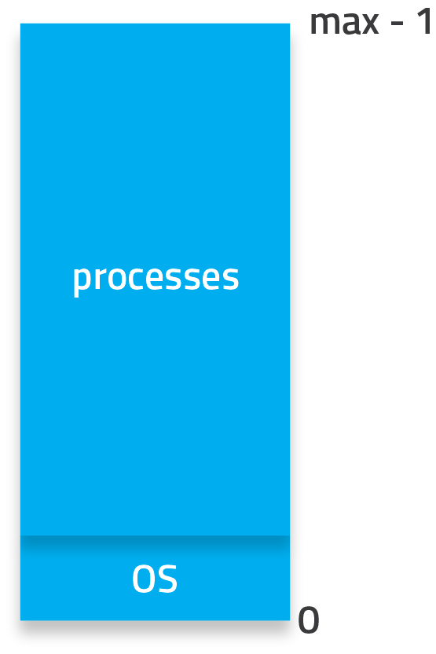
Memory Allocation – Contiguous
Memory must be divided up amongst all processes
Both user and kernel processes
Parts of memory must be reserved for the OS
Usually low memory
Rest of memory is distributed to other processes by the OS

Slide 27
Variable Partition Allocation
Memory is dynamically partitioned according to process sizes as each process is loaded
Higher overhead to manage but provides more flexibility
Management involves tracking used and available memory
Process can be loaded if there’s a big enough hole (contiguous block of memory) to fit the image
As processes terminated and release memory, holes of various sizes are formed
Can be allocated to processes that have been waiting
Notes:
Again not very useful in this context, but it is the basis for all dynamic storage allocation problems (not just for memory, also for file systems).

Slide 28
External Fragmentation
When those holes get too small to be used by any processes
Memory is unused but too fragmented to be used as a contiguous space
Can be debilitating to the system
Can be solved by compaction
Move process images in memory so all holes are compressed into one
Can only be done if processes can be dynamically relocated

Slide 29
Dynamic Storage Allocation
First-fit:
First hole found in memory that is big enough for the process
Best-fit:
Smallest hole found in memory that can fit the process
Worst-fit:
Biggest hole found in memory that can fit the process
What are the pros and cons of each strategy?

Slide 30
Cache
When the processor core writes to memory, the cache controller has two alternatives for its write policy:
write back – the cache controller writes data modifications to cache and not update to RAM until absolutely necessary. When controller writes a value to cache memory, it sets the dirty bit true. If the cache controller detects a dirty cache line, it is automatically written out to main memory.
write-buffer or write through the cache controller writes data to RAM and cache simultaneously.

Slide 31
CPU cache
CPU cache: L1 or L2 . The processor looks for the cache line in the following order:
L1
L2
Last level cache
Memory (RAM)
Once the cache line is in L1, the new data is written to it and the line is marked as modified
Data transfer from cache to CPU and registers is usually a hardware function without operating system intervention. Instead data transfer from disk to memory is usually controlled by the operating system.

Slide 32
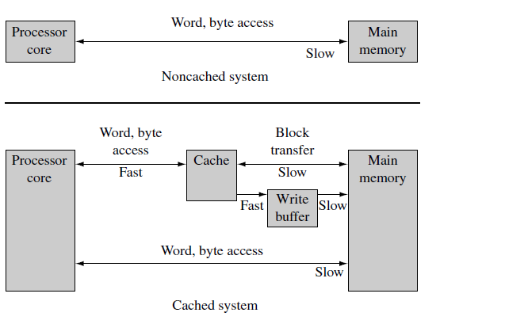
Cache and Main Memory Access

Slide 33
Logical vs. Physical Address Space
Memory has two views of addresses :
Virtual (logical) addresses that are assigned by the compiler and linker when locating a program in memory (programmers view).
Physical addresses are used to access the actual hardware components of main memory where the programs are physically located (system view).
Logical and physical addresses are the same in compile-time and load-time address-binding schemes; logical (virtual) and physical addresses differ in execution-time address-binding scheme

Slide 34
Memory-Management Unit (MMU)
Memory Management Unit (MMU) is a hardware-based memory management unit which translates virtual address to physical address.
Each task is provided its own virtual (logical ) memory map for the purpose of compiling and linking the code and data, which make up the task. A kernel layer then manages the placement of the multiple tasks in physical memory so they have a distinct location in physical memory that is different from the virtual location it is designed to run in.

Slide 35
MMU
To permit tasks to have their own virtual memory map, the MMU hardware performs address relocation.
Address relocation is the translation of the address issued by the processor core to a different address in main memory. The translation is done by the MMU hardware
The easiest way to understand the translation process is to imagine a relocation register located in the MMU between the core and main memory.
The ARM processors MMU hardware has multiple relocation registers supporting the translation of virtual memory to physical memory. The MMU needs many relocation registers to effectively support virtual memory because the system must translate many pages to many page frames

Slide 36
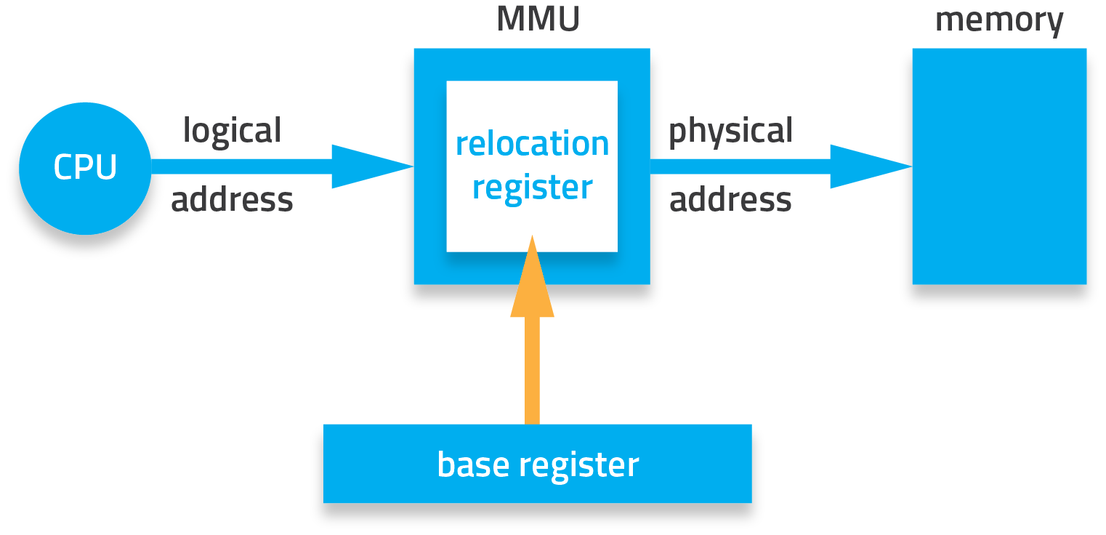
Basic MMU Address Translation
Notes:
MMU stores the base register value from the PCB into the relocation register.

Slide 37
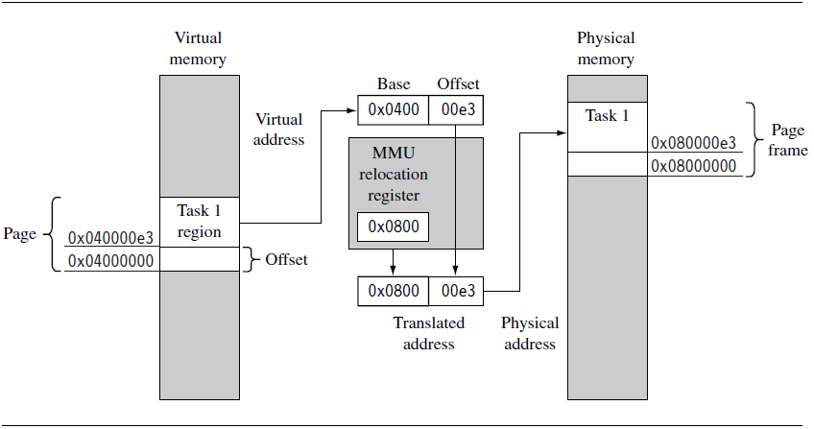
Address Translation and MMU

Slide 38
Paging
A single relocation register can only translate a single area of memory, which is set by the number of bits in the offset portion of the virtual address.
This area pointed by logical memory address is known as a page.
The area of physical memory pointed to by the translation process is known as a page frame. Page frames represent the smallest unit of system memory, and an instance of struct_page is created for each page in RAM.The OS keeps track of page frames usage.

Slide 39
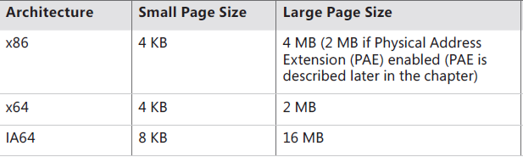
Paging
To run a program of size N pages it requires to find N free page frames to load the program
Pages and respective pages frames are stored in Page Tables
CPU (cores) divides a process into equal size of pages. Usually the page size in most current OS is 4096 bytes = 4KB = 2¹²

Slide 40
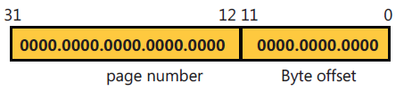
Pages
In Linux default page size can be found using getconf PAGESIZE or check the macros in header page.h
Logical address generated by CPU is divided into:
Page number (p) – used as an index into a page table which contains base address of each page in physical memory
Page offset (d) – combined with base address to define the physical memory address that is sent to the memory unit

Slide 41
Internal Fragmentation
If memory must be allocated in specific sizes, then there may be wasted space
Allocated to a process but unused by the process
E.g. memory has to be allocated in 4KB chunks
A process is loaded and only requires 3KB
The process will be given 4KB
The 1KB that is not used but is assigned to the process is wasted
Sometimes it’s better to waste than try to reclaim it!

Slide 42
Page Tables and PTEs
Page Tables contain descriptions of virtual page information. A page table entry (PTE) are organized by virtual address and contains the translation data to map a page in virtual memory to a page frame in physical memory.
A page table is a simple array of PTEs. When many page tables are needed an index to Page Tables is required. The index pointing to each page table will be stored in a Page Directory entry

Slide 43
Page Tables and PTEs
The virtual address’s page table index field indicates which PTE within the page table corresponds to and describes the data page in question.
A page table entry (PTE) in a page table contains the following information about a virtual page:
the physical base address used to translate the virtual page to the physical page frame,
the access permission assigned to the page, and the cache and write buffer configuration for the page.

Slide 44
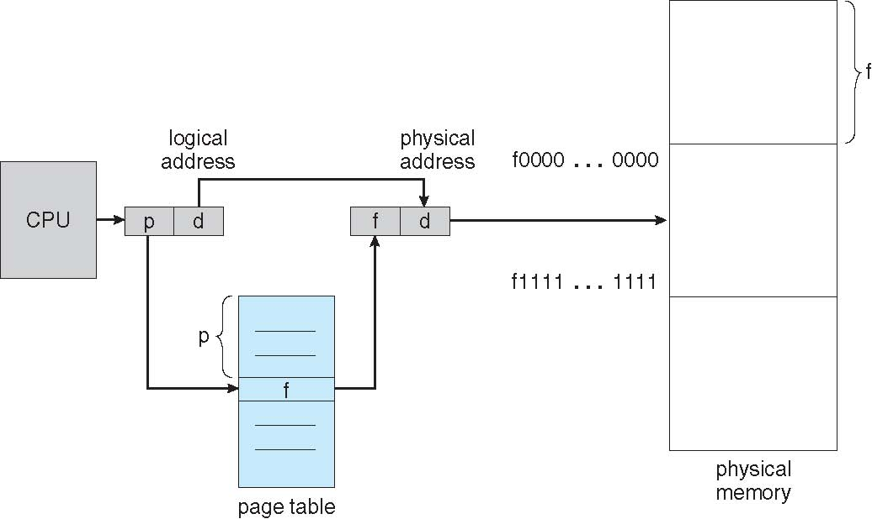
Pages and Page Table

Slide 45
Page Table Structure
The page table index is 10 bits wide, allowing you to reference up to 1,024 4-byte PTEs. Of course, because x86 provides a 4-GB virtual address space, more than one page table is needed to map the entire address space.
To calculate the number of page tables required to map the entire 4-GB virtual address space, divide 4 GB by the virtual memory mapped by a single page table.
Recall that each page table on an x86 system maps 4 MB of data pages. Thus, 1,024 page tables (4 GB / 4 MB) are required to map the full 4-GB address space. This corresponds with the 1,024 entries in the page directory

Slide 46
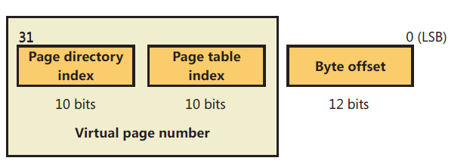
Page Table Structure
For example, the byte offset is 12 bits because it denotes a byte within a page, and pages are 4,096 bytes (2¹² =4,096).
The other indexes are 10 bits because the structures they index have 1,024 entries (2¹⁰ = 1,024).
Consider a 32-bit logical address space as on modern computers with Page size of 4 KB (2¹²), the Page table would have 1 million entries (2³² / 2¹²).

Slide 47
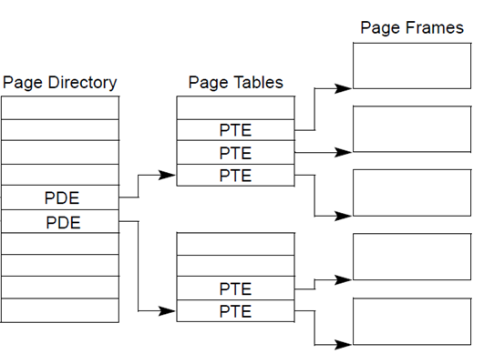
Page Tables structure

Slide 48
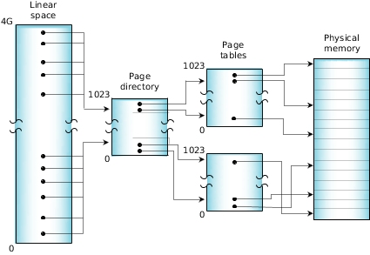
X86 - Two Level Page Table Structure

Slide 49
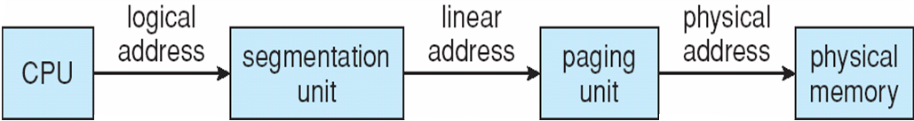
Logical to Physical Address Translation in IA-32
31 22 21 12 11 0
Page table
selector
Page table
entry selector
Byte within page
10 bits
10 bits
12 bits

Slide 50
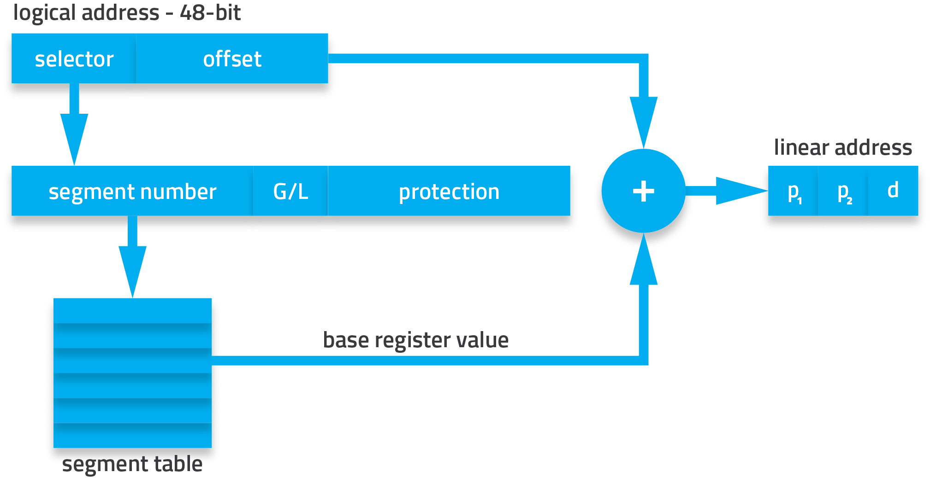
Intel x86 Address Translation

Slide 51
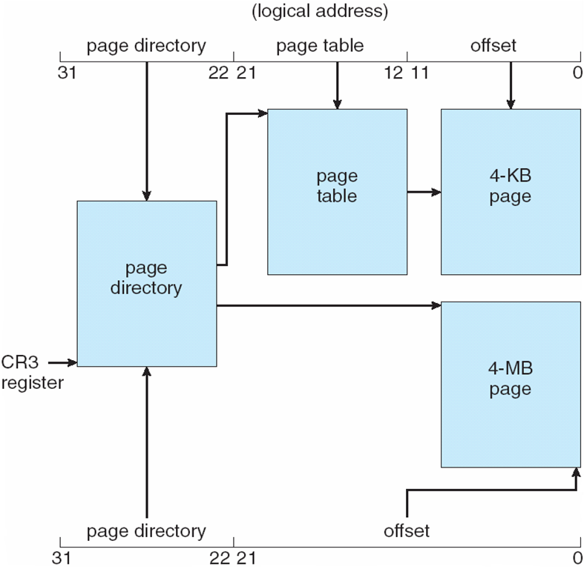
Intel IA-32 Two-Level Page table

Slide 52
ARM MMU and Two Level Page table
The hardware has a multilevel page table architecture. There are two levels of page table: level 1 (L1) and level 2 (L2).
There is a single level 1 page table known as the L1 master page table that can contain two types of page table entry. It can hold pointers to the starting address of level 2 page tables, and page table entries for translating 1 MB pages.

Slide 53
ARM MMU and Two Level Page table
The master L1 page table divides the 4 GB address space into 1 MB sections; hence the L1 page table contains 4096 page table entries. The master table is a hybrid table that acts as both a page directory of L2 page tables and a page table translating 1 MB virtual pages called sections.
If the L1 table is acting as a directory, then the PTE contains a pointer to either an L2 coarse or L2 fine page table that represents 1 MB of virtual memory. If the L1 master table is translating a 1 MB section, then the PTE contains the base address of the 1 MB page frame in physical memory

Slide 54
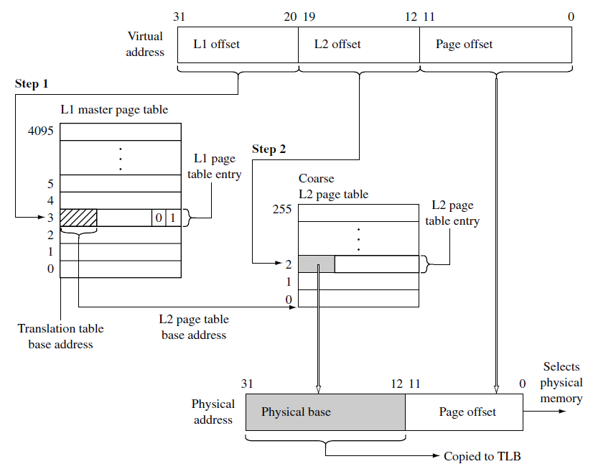
ARM –Two Level Page Table

Slide 55
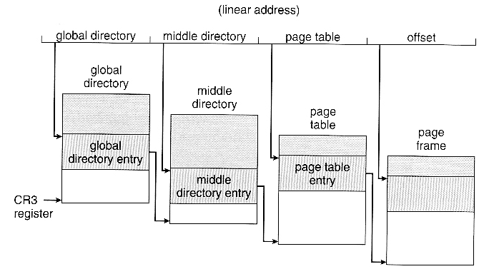
Linux -Three Level Page Table Structure

Slide 56
X64 Virtual Addressing
AMD’s and Intel’s current x64 processors implement only 256 TB of virtual address space. That is, only the low-order 48 bits of a 64-bit virtual address are implemented.
Windows on x64 has limitation: of the 256 TB of virtual address space available on x64 processors, Windows at present allows only the use of a little more than 16 TB. This is split into two 8-TB regions, the user mode, per-process region starting at 0 and working toward higher addresses (ending at 0x000007FFFFFFFFFF), and a kernel-mode, system wide region starting at “all Fs” and working toward lower addresses, ending at 0xFFFFF80000000000 for most purposes.
In practice only implements 48 bit addressing
Page sizes of 4 KB, 2 MB, 1 GB
Four levels of paging hierarchy

Slide 57
64 (Itanium) Virtual Address Space
64-bits = 17,179,869,184 GB
x64 today supports 48 bits virtual = 262,144 GB
IA-64 today support 50 bits virtual = 1,048,576 GB
x64
Itanium
8192 GB
(8 TB)
User
process
space
7152 GB
(7 TB)
User
process
space
6657 GB
System
Space
6144 GB
System
Space
Notes:
7

Slide 58
64-bit ia64 (Itanium) Virtual Address Space
00000000 00000000
User mode space per process
64 bits = 2^64 = 17 billion GB (16 Exabytes) total
7152 GB default per-process
Pages are 8 Kbytes
All pointers are now 64 bits wide (and not the same size as a ULONG)
6FC 00000000
Kernel mode
per process
1FFFFF00 00000000
Process page tables
20000000 00000000
Session space
3FFFFF00 00000000
Session space page tables
E0000000 00000000
System space
E0000600 00000000
FFFFFF00 00000000 FFFFFFFF FFFFFFFF
System space page tables

Slide 59
X64-64-bit Page Table Structure
The page map level The base physical address of this page map is stored in CR3.
A set of page directory pointer tables — An entry in a page directory pointer table contains the physical address of the base of a page directory table, access rights, and memory management information.
Sets of page directories — An entry in a page directory table contains the physical address of the base of a page table, access rights, and memory management information.
Sets of page tables — An entry in a page table contains the physical address of a page frame, access rights, and memory management information

Slide 60
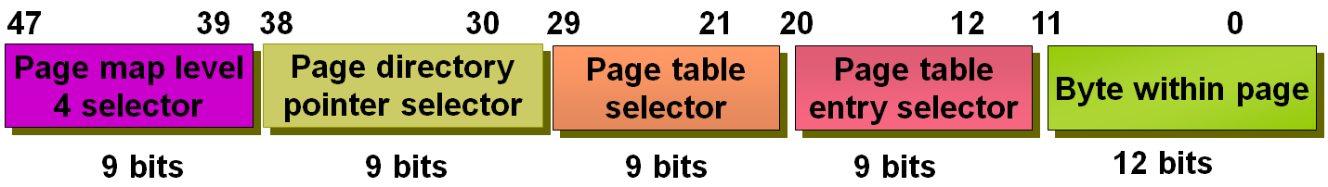
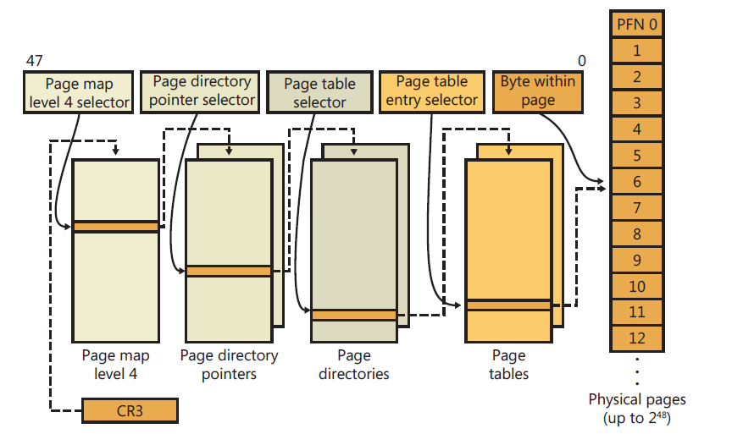
X64-64-bit Page Table Architecture

Slide 61
TLB
The Page table is kept in main memory. Page-table base register (PTBR) points to the page table
In this scheme every data/instruction access requires two memory accesses :One for the page table and one for the data / instruction. When a system requires many pages tables, access to the address translation can take long time. One way to solve the problem is implementing a hardware cache called translation look-aside buffers (TLBs)
The translation look-aside buffers (TLBs) is a special hardware cache implementation that stores recently used page translations.

Slide 62
TLB
The TLB maps a virtual page to an active page frame and stores control data restricting access to the page.
TLBs are typically small (64 to 1,024 entries)
On a TLB miss, value is loaded into the TLB for faster access next time
Replacement policies must be considered
In ARM processor cores the TLB uses a round-robin algorithm to select which relocation register to replace on a TLB miss.

Slide 63
TLB hit and miss
During a memory access, the MMU compares a portion of the virtual address to all the values cached in the TLB.
If the requested translation is available, it is a TLB hit, and the TLB provides the translation of the physical address.
If the TLB does not contain a valid translation, it is a TLB miss. The MMU automatically handles TLB misses in hardware by searching the page tables in main memory for valid translations and loading them into one of the 64 lines in the TLB.
The search for valid translations in the page tables is known as a page table walk.
If there is a valid PTE, the hardware copies the translation address from the PTE to the TLB and generates the physical address to access main memory.
If, at the end of the search, there is a fault entry in the page table, then the MMU hardware generates an abort exception.

Slide 64
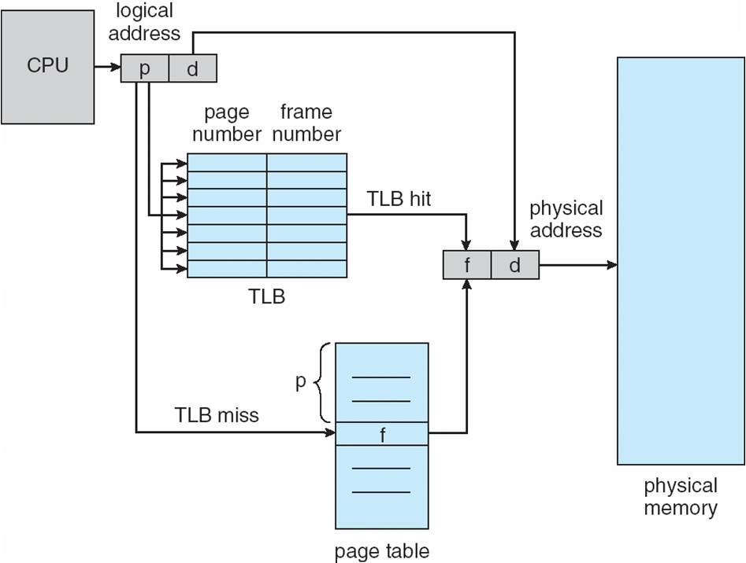
Paging Hardware With TLB

Slide 65
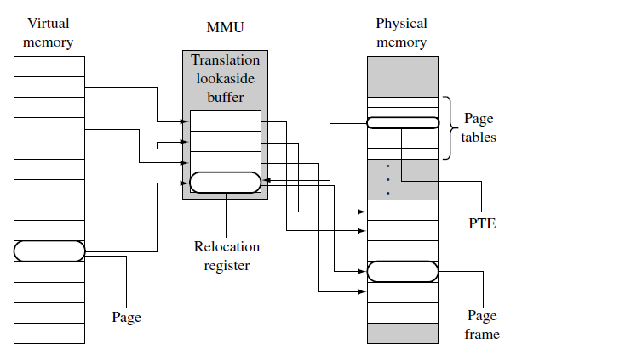
TLB in ARM processors

Slide 66
ARM MMU
The MMU function of ARM processors are to:
read level 1 and level 2 page tables and load them into the TLB
store recent virtual-to-physical memory address translations in the TLB
perform virtual-to-physical address translation
enforce access permission and configure the cache and write buffer

Slide 67
Memory Protection
Memory protection implemented by associating protection bit with each frame to indicate if read-only or read-write access is allowed
Can also add more bits to indicate page execute-only, and so on
Valid-invalid bit attached to each entry in the page table:
“valid” indicates that the associated page is in the process region’ logical address space, and is thus a legal page
“invalid” indicates that the page is not in the process ’ logical address space
Or use page-table length register (PTLR)
Any violations result in a trap to the kernel

Slide 68
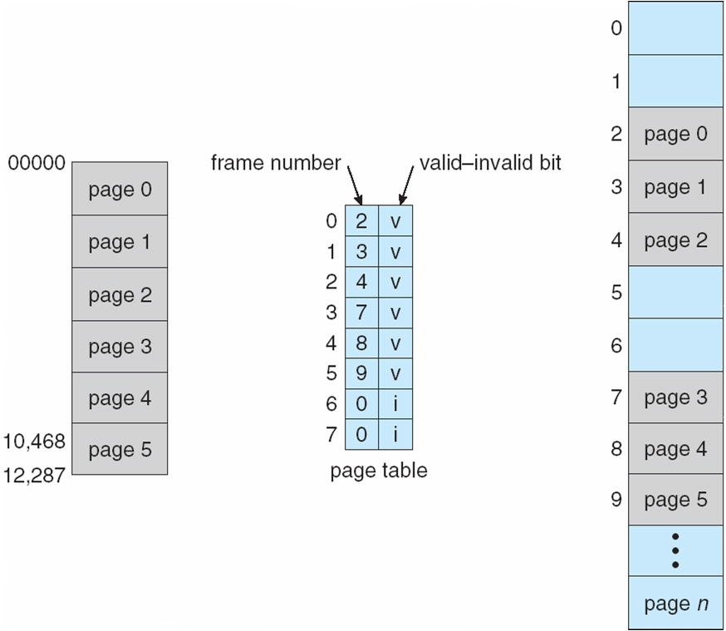
Valid (v) or Invalid (i) Bit In A Page Table

Slide 69
Shared Pages
Shared code
One copy of read-only (reentrant) code shared among processes (i.e., text editors, compilers, window systems)
Similar to multiple threads sharing the same process space
Also useful for inter-process communication if sharing of read-write pages is allowed
Private code and data
Each process keeps a separate copy of the code and data
The pages for the private code and data can appear anywhere in the logical address space

Slide 70
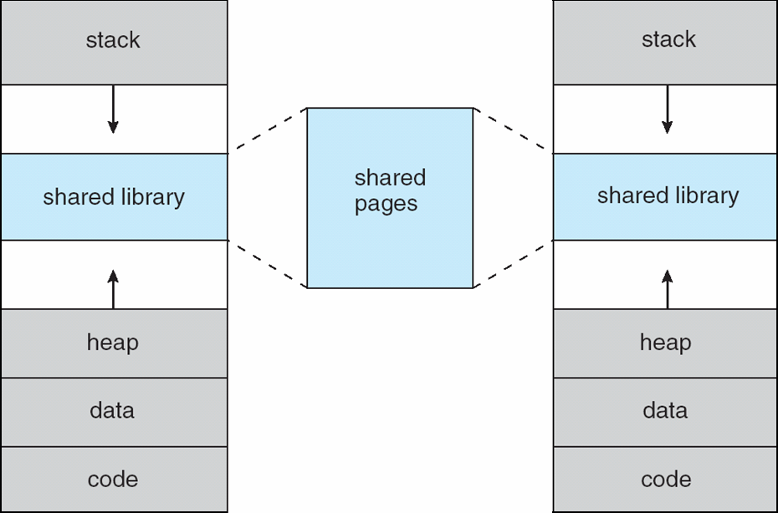
Shared Library Using Virtual Memory

Slide 71
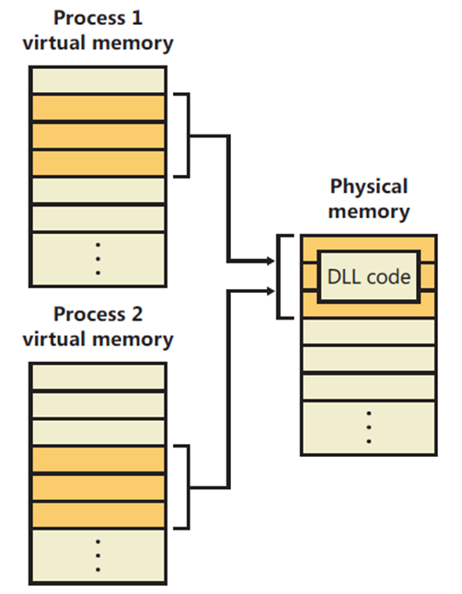
Shared Pages among Windows processes

Slide 72
Linux Memory Management
How Linux kernel manages memory ?
Access the following web site and read basic concepts of Linux memory management http://www.tldp.org/LDP/tlk/mm/memory.html
http://duartes.org/gustavo/blog/post/how-the-kernel-manages-your-memory/
https://linux-mm.org/LinuxMMInternals
https://linux-mm.org/LinuxMMDocumentation

Slide 73
References
http://duartes.org/gustavo/blog/post/page-cache-the-affair-between-memory-and-files/
ARM System Development Guide book – Chapter 14 - “Memory Management”
https://www.youtube.com/watch?v=AjTl53I_qzY&list=PLI63-CUdihCrI3eAG2UN6hGR6CiS1yTMV

Slide 74
References
Operating System Concepts. Silberschatz, Galvin, Gagne. Latest Version. John Wiley & Sons.
All images are ©2016 Southern Alberta Institute of Technology unless otherwise indicated.

